Slide 1





AI-POWERED INDUSTRIAL OPERATIONS INTELLIGENCE PLATFORM
SAFETY • MACHINERY OPERATIONS • INVENTORY

Slide 2

THE REALITY INSIDE MANUFACTURING
OPERATIONS
⚠ Delayed safety incident response
⚙ Unexpected machine breakdowns
📉 Limited real-time visibility
📦 Inventory mismatches

Slide 3


WHY CURRENT SYSTEMS FAIL
🧩No unified intelligence
📉 Productivity loss
⚙ Unplanned downtime
📦 Inventory imbalance
⚠ Safety & compliance risks

Slide 4

ONE PLATFORM. ONE OPERATIONAL VIEW.
Workers | Machines | Safety | Inventory
↓
Unified Operations Intelligence
↓
Manager Decisions

Slide 5

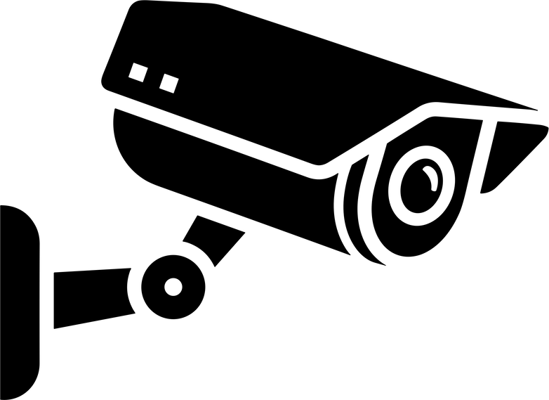
MODULE 1 – SAFETY INTELLIGENCE
🎥 CCTV-based monitoring
🤖 AI incident detection
📝 Auto-generated reports
🚨 Instant alerts

Slide 6

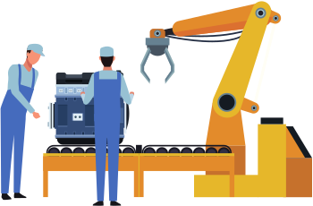
MODULE 2 – MACHINERY INTELLIGENCE
⚙ Machine condition monitoring
📈 Vision + sensor inputs
🔧 Early fault detection
🟢🟡🔴 Machine health status indicators

Slide 7


MODULE 3 – PERFORMANCE ANALYSIS
📈 Performance KPIs
🧠 Decision intelligence
🔔 Smart alerts & suggestions
📊Real-time performance tracking

Slide 8
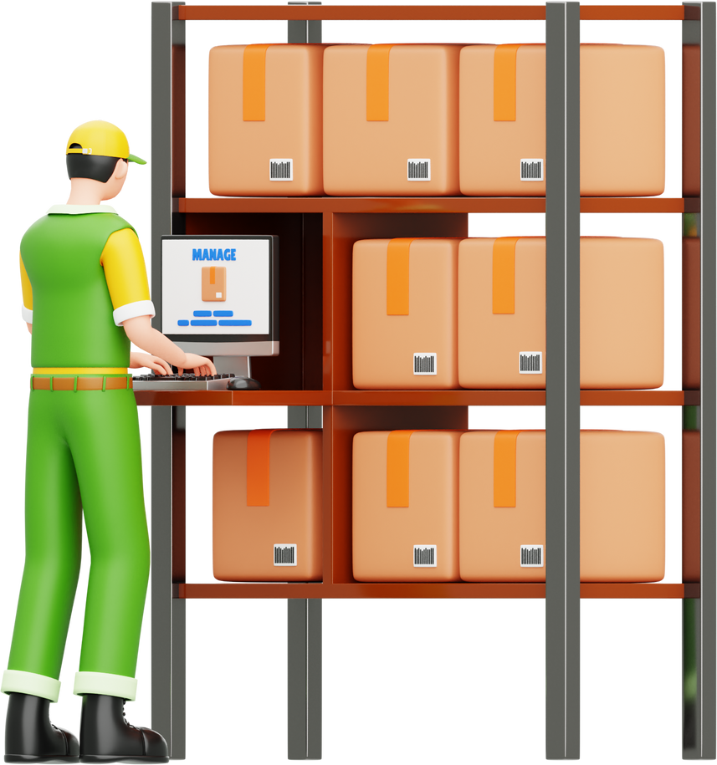

MODULE 4 – INVENTORY INTELLIGENCE
📦Real-time stock tracking
⏳ Demand prediction
🔄 Reorder alerts
📉 Demand prediction based on production trends
🔔 Automated reorder alerts

Slide 9
LET’S EXPLORE THIS TOGETHER
We would welcome the opportunity to present the detailed working of this platform and receive industry guidance to validate and refine this concept.
Team Name
College
Contact

Slide 10
THANK YOU

